Slide 1
NGT Monthly Team Meeting
May 2026
14.05.26

Slide 2
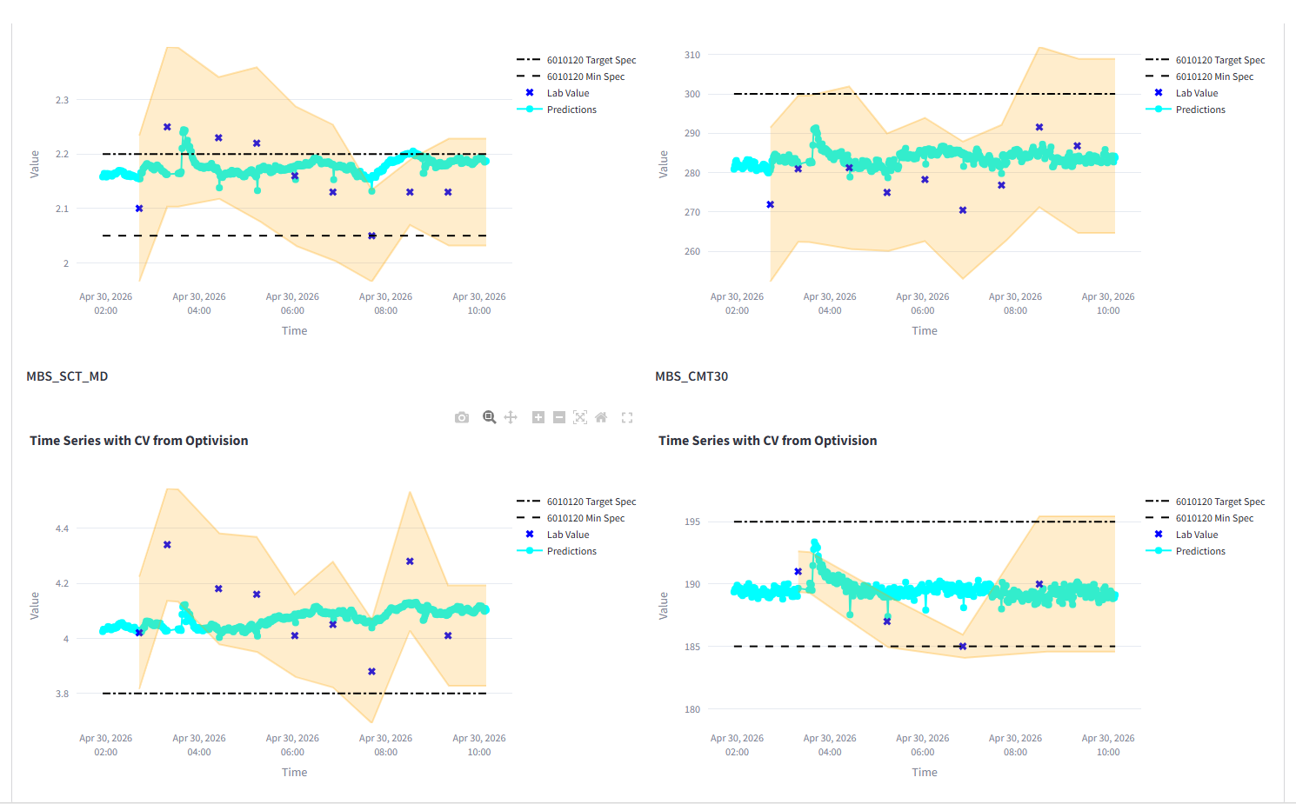
Online Strength Predictions
UOC Models deployed in dev & prod
Habber workload managed monthly by defining tasks + maintenance

Slide 3
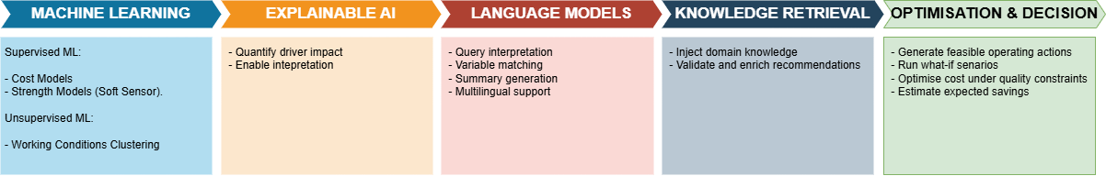
AI is used across the decision chain
— AI enhances the system, but execution remains controlled and deterministic.

Slide 4
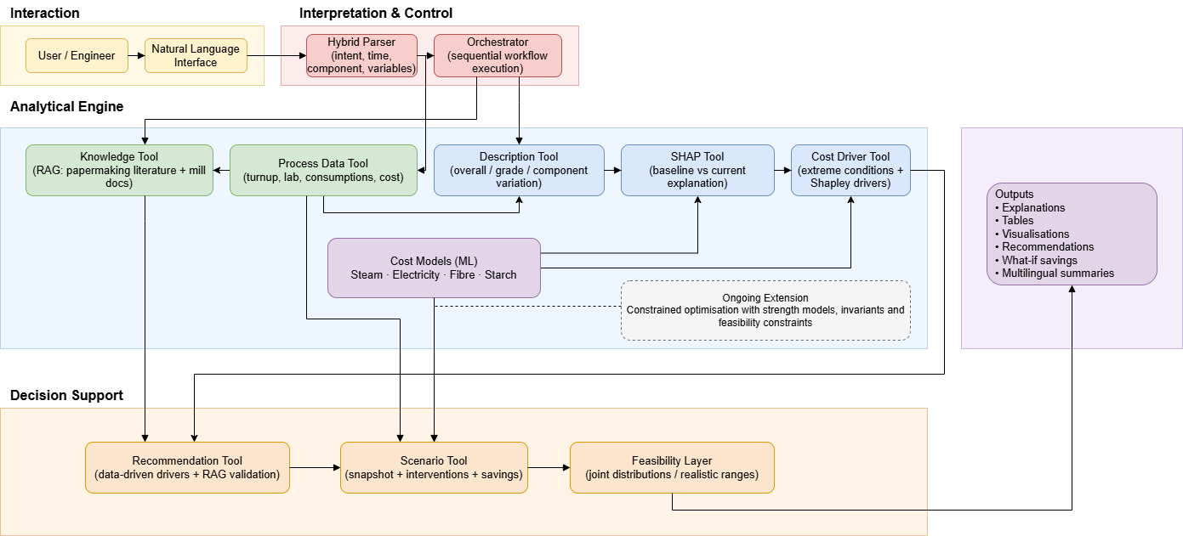
Diagram

Slide 5
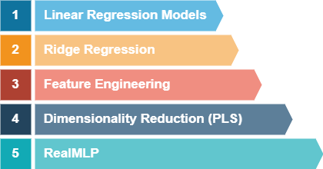
AI Analytics Engine - Modelling
Models capture the knowledge of the process
Can be combined as cost functions
New models capture non-linearities + interactions

Slide 6
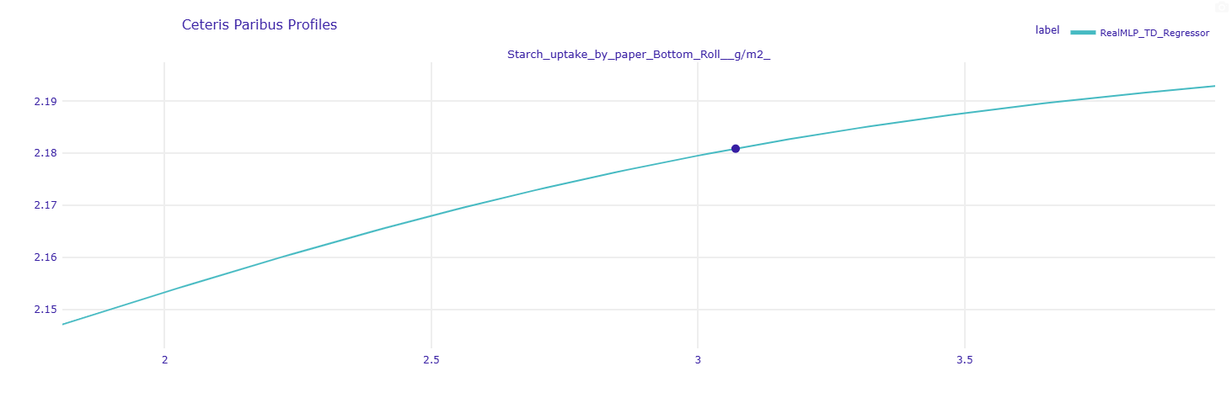
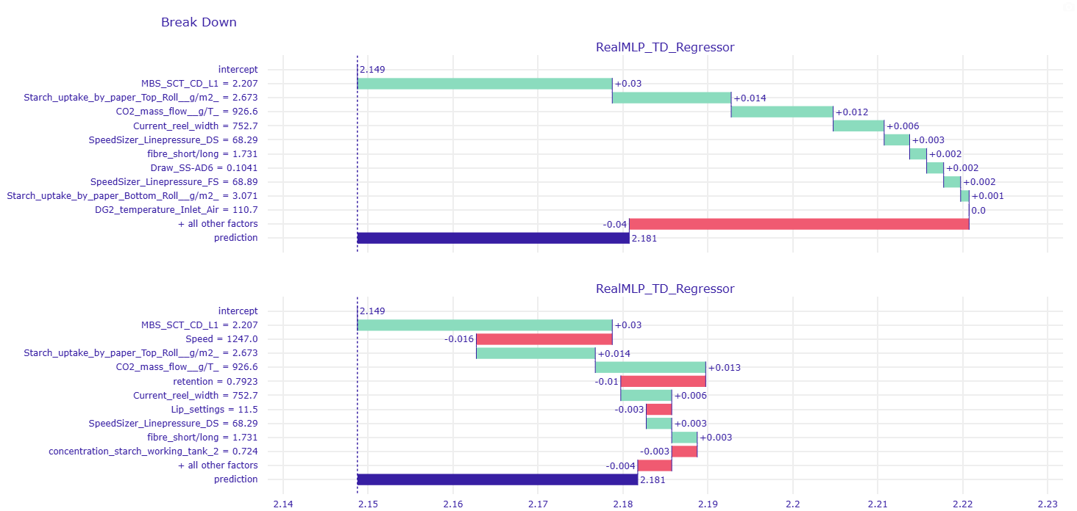
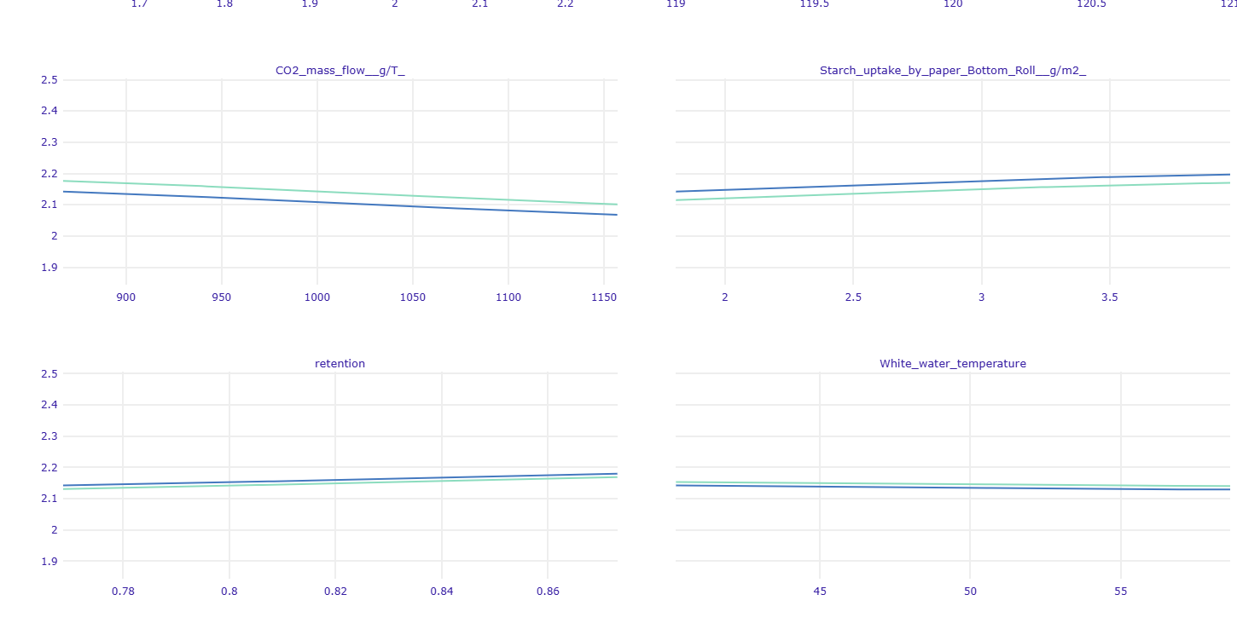
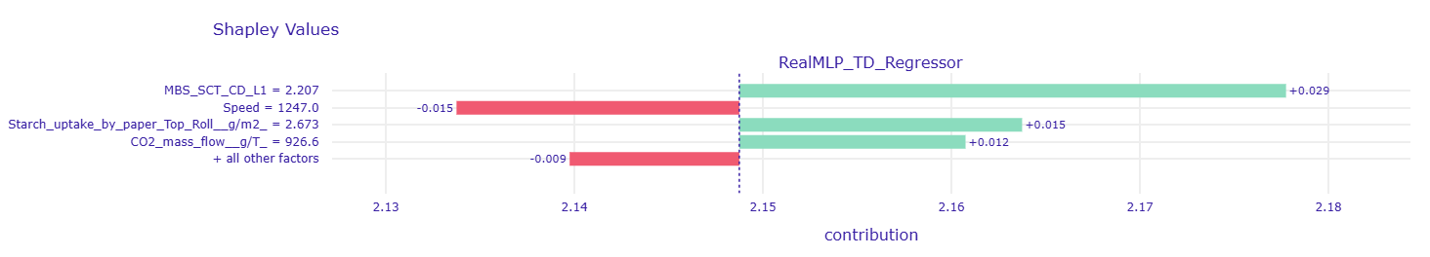
AI Analytics Engine – Modelling + Explainability

Slide 7
AI Analytics Engine - Recommendations
So far:
recommendations based on cost drivers compared to what happened before
Actions defined as small variations from current conditions
Clipped using joint distribution
Now (in progress):
Recommendations based on cost + strength functions (ML models)
Optimisation from current conditions constrained by
Invariants
Joint distributions
Minimum strength over specs

Slide 8


